Slide 1

Training & optimizing ML models on GCP for natality data
BabyShark

Slide 2


Slide 3

Introduction
Alterimac is a company that specializes in developing big data ecosystems to extract valuable insights. Their clients have recently expressed a need for advanced machine learning techniques to be integrated into the data analysis process in order to gain even more valuable insights.

Slide 4
Components Used
01. Data Prep
02. Big Query SQL
03. GCS
04. Dataproc
05. Big Query ML

Slide 5
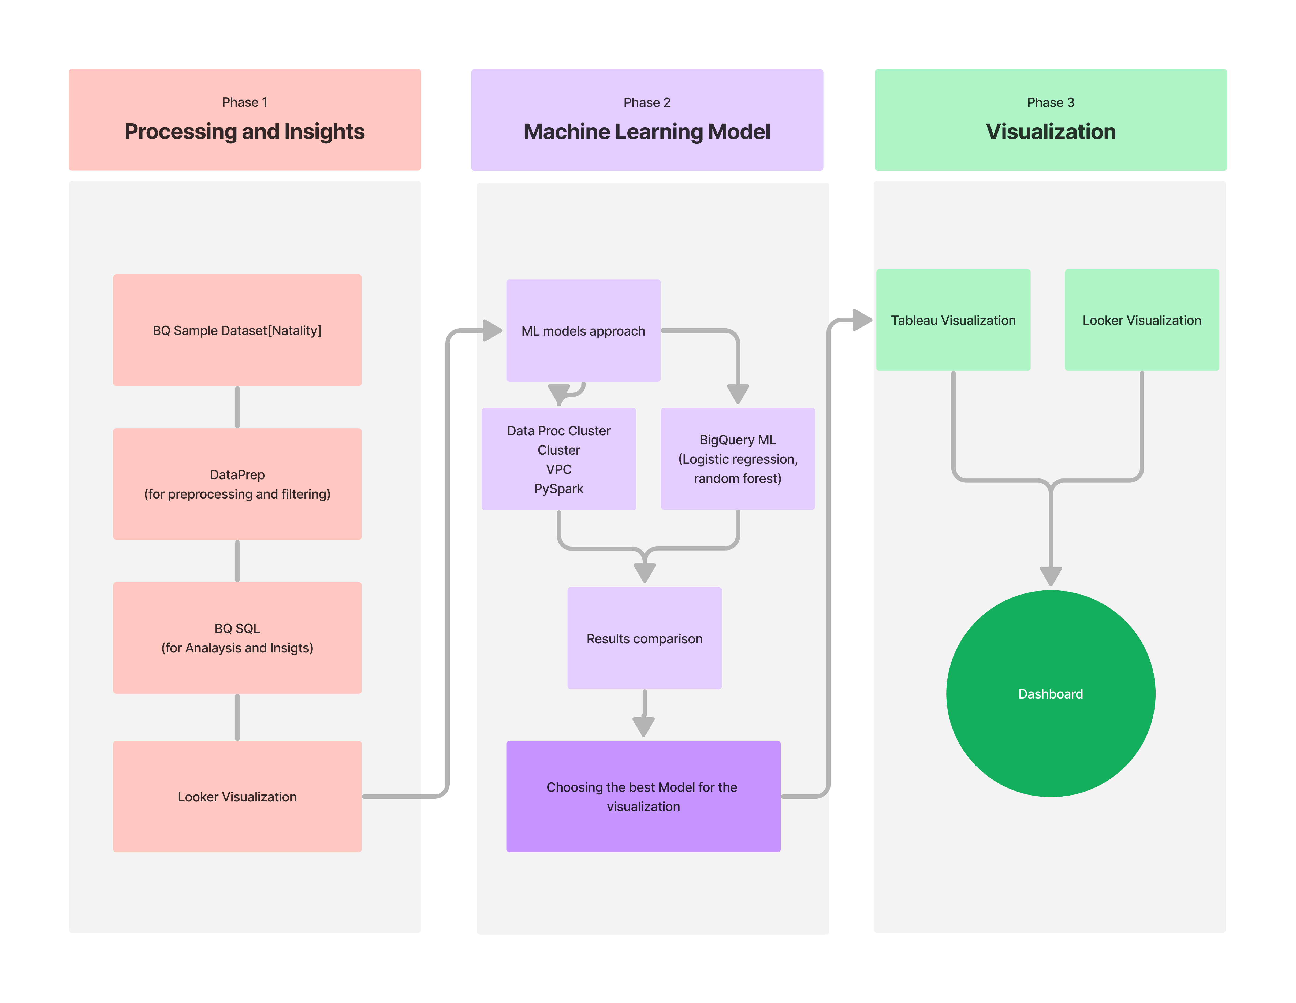
WorkFlow

Slide 6
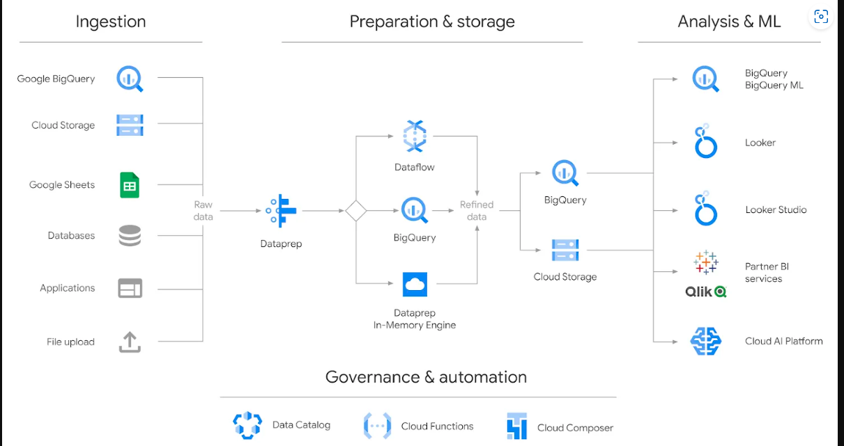
How data flows?
Ingestion -: Data ingestion is the process of collecting data from various sources and moving it to a destination where it can be accessed, used, and analyzed.
Prep & Storage -: Changing raw data to clean & to store that clean data.
Analysis & ML -: Extraction of meaningful insights, visualization of data & applying ML models.

Slide 7

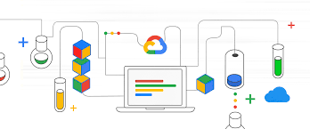
Data Preparation
Data preparation is nothing but a process of exploring, cleaning, and modifying raw and messy data so that it can be used for reporting, analysis, and evaluation of machine learning algorithms. It is done to prepare and structured or unstructured data ready for implementation.
Steps involving data preparation -:
Discover.
Structure.
Clean.
Enrich.
Validate.

Slide 8
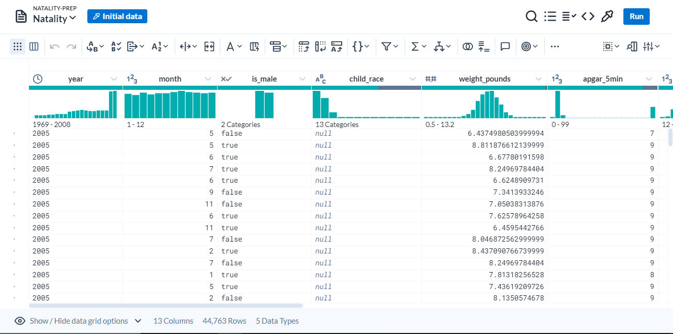
Data Prep by Trifacta
Data-prep by Trifacta is an intelligent data service for visually exploring, cleaning, and preparing structured and unstructured data for analysis, reporting, and machine learning.
Data-prep by Trifacta helps to do the following:
Cut time to prepare actionable data
Avoid IT bottlenecks and reliance on data scientists in data prep
Deliver tools to prepare data to the people who understand the data
Eliminate manual prep work
Surface data quality issues in a way that's easy to fix them

Slide 9
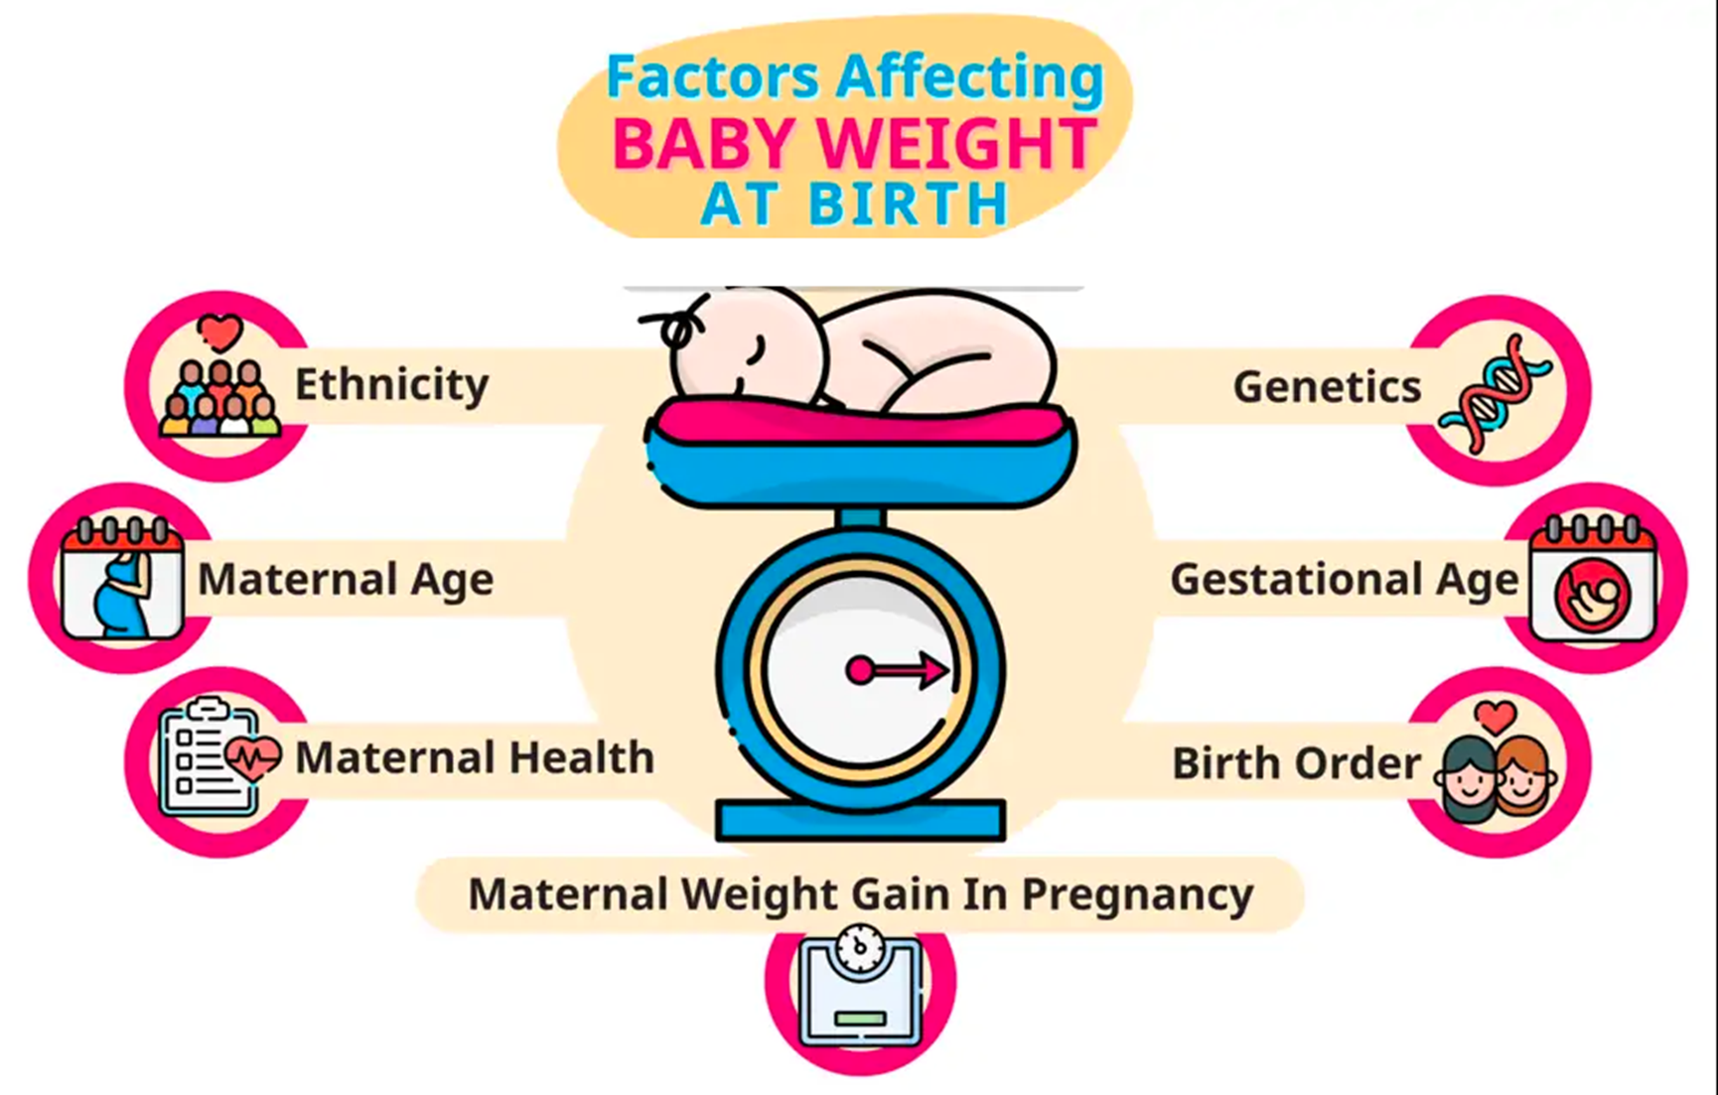

Slide 10
PIVOTAL FACTORS
YEAR
MONTH
IS MALE
CHILD RACE
WEIGHT POUNDS
PLURALITY
APGAR 5 MIN
MOTHER AGE
GESTATION WEEKS
CIGARATTE USE
ALCOHOL USE
WEIGHT GAIN POUNDS
EVER BORN
FATHER AGE

Slide 11
BIGQUERY SQL ANALYSIS

Slide 12
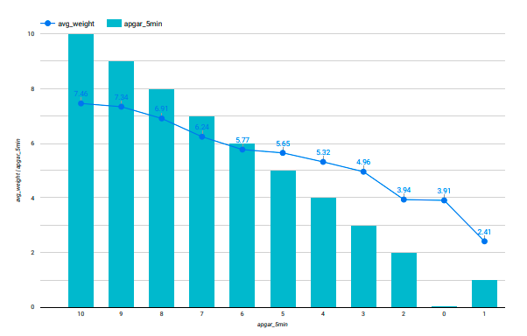
Appearance, Pulse, Grimace, Activity and Respiration

Slide 15


How to secure a DataProc cluster with a custom VPC
VPC : A virtual private cloud (VPC) is a secure, isolated private cloud hosted within a public cloud. VPC customers can run code, store data, host websites, and do anything else they could do in an ordinary private cloud.

Slide 16
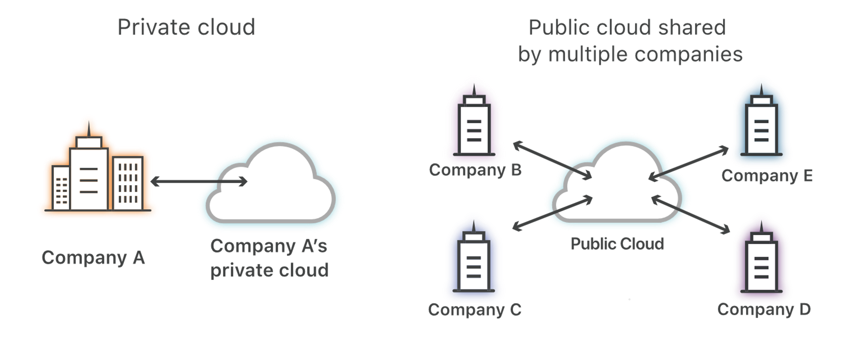
Private Cloud vs Public Cloud
A public cloud is shared cloud infrastructure. Multiple customers of the cloud vendor access that same infrastructure, . Public cloud service providers include AWS, Google Cloud Platform, and Microsoft Azure, among others.
A private cloud, however, is single-tenant. A private cloud is a cloud service that is exclusively offered to one organization. A virtual private cloud (VPC) is a private cloud within a public cloud; no one else shares the VPC with the VPC customer
How to isolate Private cloud with Public cloud ?
Subnet

Slide 17
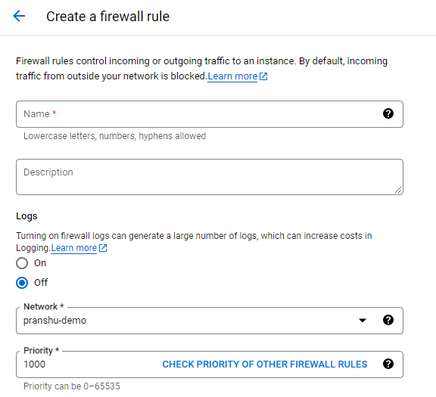
CREATING FIREWALL RULE
Step 1: Give a name to your firewall rule and a description about it.
STEP 2: If u wish to see the log generation then allow on.
STEP 3: Choose the vpc to which u want to connect and priority

Slide 18
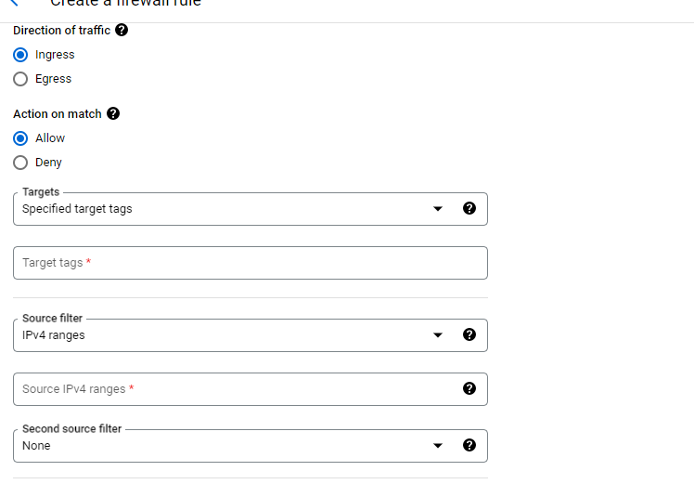
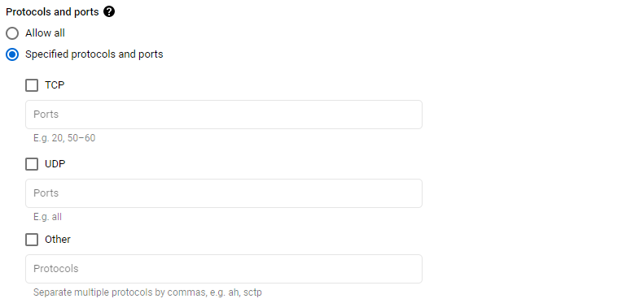
STEP 4: Choose the direction of traffic i.e. Incoming or outgoing
SETP 5 : Choose the action
STEP 6 : Choose the target tags
STEP 7 : Choose source filter
STEP 8 : Choose the specific port and protocol

Slide 19
Create a Cloud NAT gateway : If your cluster needs outbound internet access, you can create a Cloud NAT gateway. This allows the cluster nodes to access the internet without having public IP addresses assigned to them
Configure network peering : If you have other networks or VPCs in your project that need to communicate with the Dataproc cluster, you can set up network peering. Network peering enables secure communication between different networks within Google Cloud.

Slide 20


Data Compliance
Data compliance is the process of following various regulations and standards to maintain the integrity and availability of regulated data . All of this is done to help ensure the protection of regulated and/or sensitive data from unauthorized use.
It is a set of rules to safeguard users data.

Slide 21

PII Compliance
PII stands for personally identifiable information — any data that can be used to identify a specific person.
GDPR: The General Data Protection Regulation (GDPR) was instituted by the EU, and it aims to facilitate privacy policy and data protection within the EU and the European Economic Area (EEA).

Slide 22


PCIDSS
HIPPA
The Payment Card Industry Data Security Standard (PCI DSS) manages and identifies the information security policies necessary for organizations that handle credit card information. It is sometimes referred to as “PCI,” and it makes sure companies that work with credit card data keep a certain level of cybersecurity in place.
HIPPA stands for the Health Insurance Portability and Accountability Act, and it is designed to protect the sensitive data of patients. The PII definition used within the context of HIPAA is protected health information (PHI). This includes PII information regarding not just who a patient is but also the kinds of treatment they get and the health conditions they have.

Slide 23
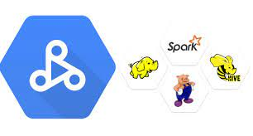
Data Proc
Service
Managed service provided by Google Cloud Platform (GCP) that allows you to easily create and manage Apache Spark and Hadoop clusters. It simplifies the process of setting up and configuring these clusters, making it convenient to run big data processing and machine learning workloads.

Slide 24
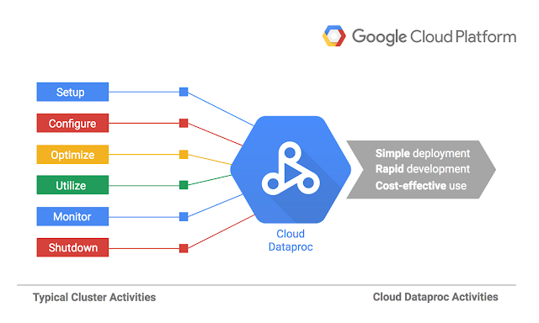
Running a SparkML project on Dataproc involves several steps:​

Slide 25
STEP 1: Create a Dataproc cluster
Begin by creating a Dataproc cluster on GCP. You can specify the number of worker nodes, machine types, and other configuration parameters based on your project requirements. Dataproc will provision the necessary resources and set up a cluster with Spark and other components.

Slide 26

STEP 2: Upload your PySpark project code and data
Prepare your PySpark project code and any required data files. You can upload these to a storage location supported by GCP, such as Google Cloud Storage (GCS). GCS provides a scalable and durable object storage service.

Slide 27

STEP 3:
Submit your PySpark job
Using the Dataproc cluster, submit your PySpark job to execute the machine learning tasks. You can do this through the gcloud command-line tool, the Google Cloud Console, or programmatically using the Google Cloud client libraries or APIs.

Slide 28
STEP 4: Job execution
Once the job is submitted, Dataproc will provision the cluster and allocate the necessary resources for executing the PySpark tasks. It will distribute the workload across the worker nodes in the cluster, leveraging the parallel processing capabilities of Spark.

Slide 29
STEP 5: Retrieve results
After the job completes, you can retrieve the output and results generated by your PySpark project. These results may include trained machine learning models, predictions, or any other relevant artifacts. You can store them in GCS or other storage options for further analysis or downstream processing.

Slide 30

Finally...
Don’t forget to delete the Data Proc cluster

Slide 31
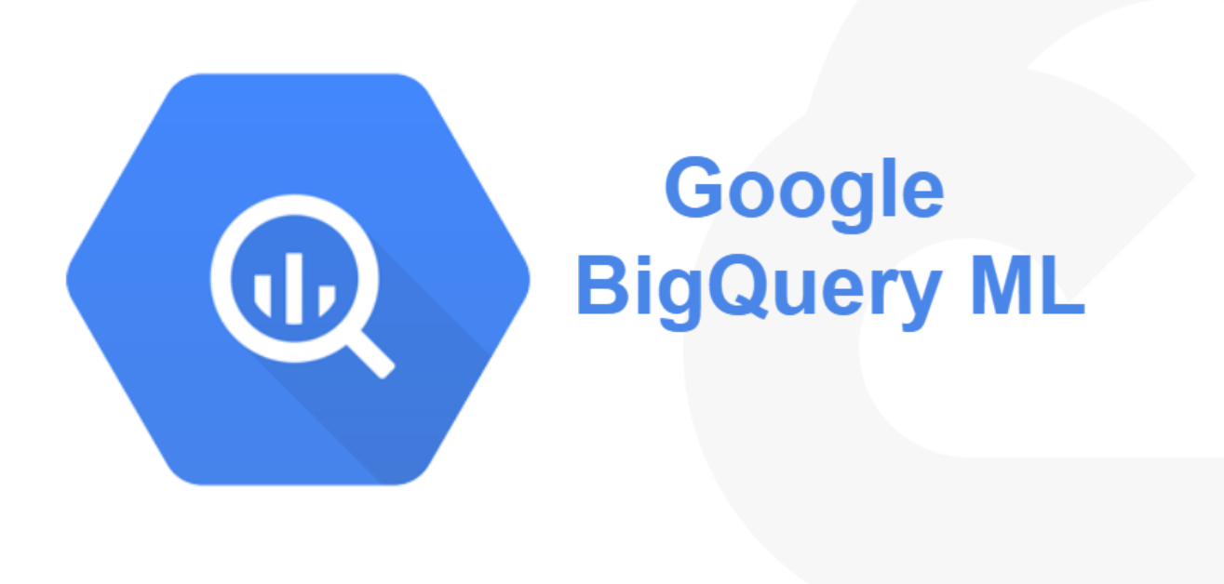
BIG QUERY ML

Slide 32
BIG Query ML
BigQuery ML enables seamless testing and execution of machine learning models directly on structured datasets within the BigQuery environment.
No need for data export or advanced programming languages, simplifying the model development process.
Supports a range of built-in model types, including linear regression, logistic regression, k-means clustering, and matrix factorization.

Slide 33
Different ML algorithms we considered
Neural Networks: Neural Network is one of the supervised learning models available in BigQuery ML that can be used for tasks such as classification and regression on large datasets
Decision trees: Effective for both classification and regression tasks, decision trees create a model by partitioning the data based on a set of decision rules.
Random forests: An ensemble learning method that combines multiple decision trees to improve predictive accuracy.
Linear Regression: Linear regression is one of the easiest and most popular Machine Learning algorithms. It is a statistical method that is used for predictive analysis.

Slide 34
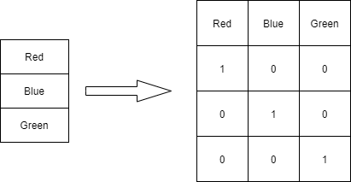
Machine learning Jargons
R2 Score:
the R2 score represents the proportion of the response variable's variance that is captured by the regression model. A higher R2 score indicates a better fit, while a lower score suggests that the model does not explain much of the variability in the data.​
Encoding:
Assigns vectors to each category. The vector represent whether the corresponding feature is present (1) or not (0).

Slide 35
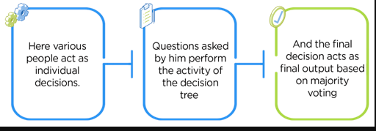
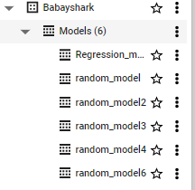
Machine learning model Run
Random Forest Regressor
Limitations
We first decided to go with 2 models test Runs.
Random Forest : It builds decision trees on different samples and takes their majority vote for classification and average in case of regression.
Computationally expensive
Giving less R2 value as the data is increasing
When we test run model with random forest we get somehow good results after running queries almost 3 hours on 6 different models.

Slide 36
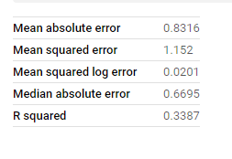
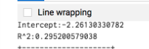
Linear regression Out performs Random forest
When we handle large datasets with low dimensionality the model will under perform in case of random forest.
when dealing with low-dimensional datasets, the random forest algorithm may not be able to effectively distinguish between important and unimportant features, leading to a reduced ability to make accurate predictions.

Slide 37
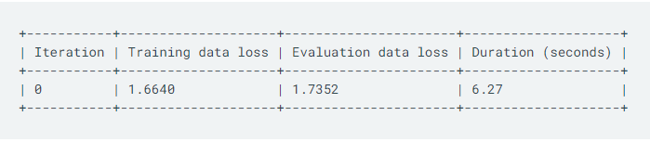
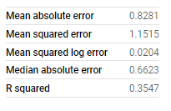
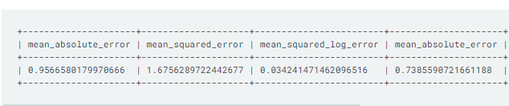
Linear regression Training
MODEL EVALUATION

Slide 38
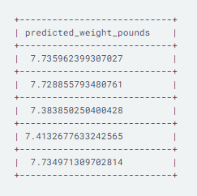
Prediction

Slide 39
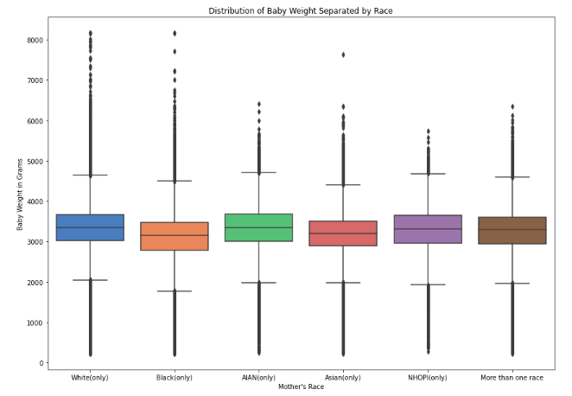
Baby Race

Slide 40
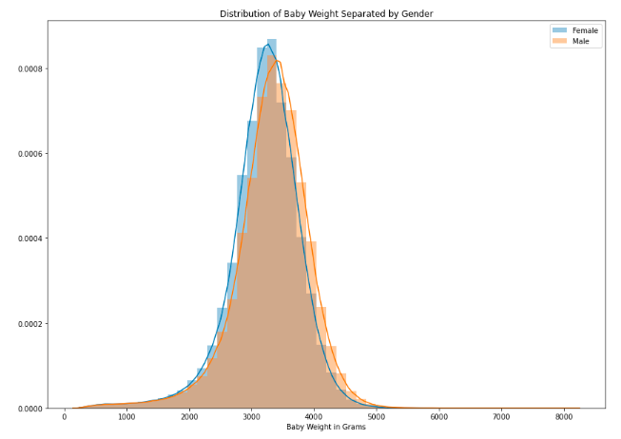
Distribution according to baby weights

Slide 41
Summary
In conclusion, Alterimac's journey into advanced machine learning has proven to be a
pivotal step in unlocking valuable data insights. By leveraging the power of BigQuery, Python, Apache Spark ML, and Dataproc, they have successfully constructed a robust architecture for machine learning on the natality dataset. Specifically, by utilizing linear regression, they have developed a model that predicts birth weight based on significant factors such as gestation weeks, mother's age, father's age, mother's weight gain during pregnancy, and Apgar score. This case study exemplifies the effectiveness of these tools in extracting meaningful information from complex datasets and showcases the potential for enhanced decision-making in various industries.

Slide 42






MEET THE TEAM
Puranjay Kwatra
Parth Tyagi
Neel Madhab Roy
Mukund Sahu
Pranshu Vashishth
Dharan Tej

Slide 43
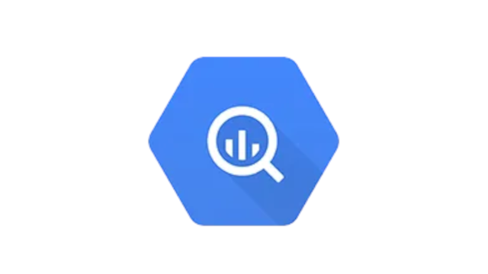
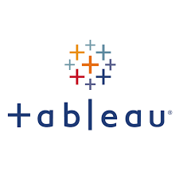




User stories
Puranjay
BigQuery ML model
Parth
Looker & Tableau visualization
Pranshu
VPC
Dharan Tej
Bucket and Dataproc cluster
Neel
BigQuery Analysis
Mukund
Data preparation

Slide 44

Slide 11
THANK YOU

